Slide 1
Implementation
Of
Inode based File System
-Team AmigOS

Slide 2
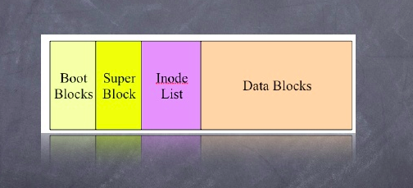
File System Structure

Slide 3
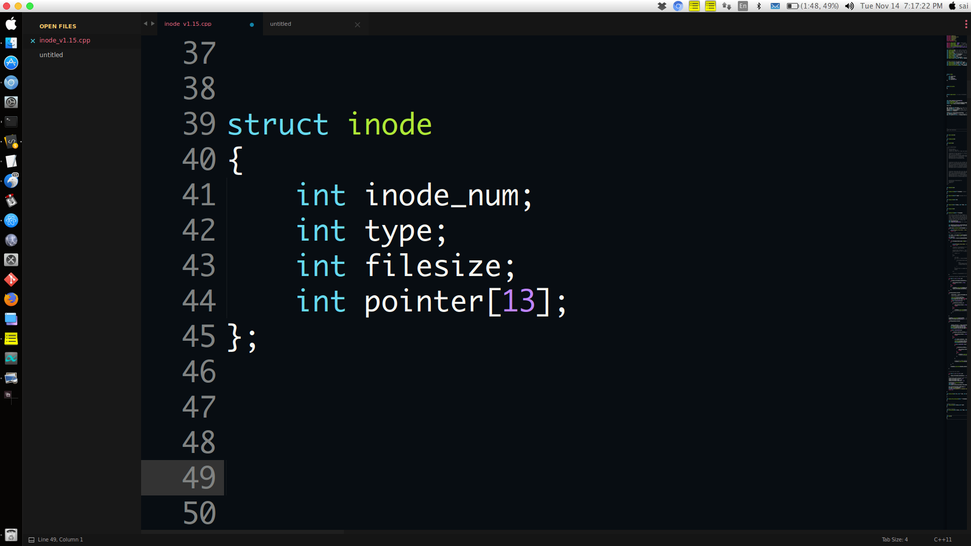
inode structure

Slide 4
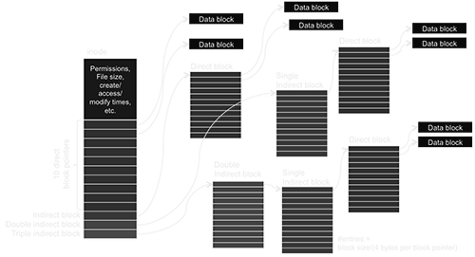
Inode structure expanded

Slide 5
Implementation:
Meta Data structure (Superblock -SB, Directory Structure-DS, inode list)
Create a virtual disk
Mount the disk ( existing / new created)
Open existing file
Read data from file
Close file
Create a empty file
Write into file
Delete a file from disk
List all stored files
Unmount the disk

Slide 6
Create Disk:
1)Create and initialize the Virtual Disk.
2)Initialize SuperBlock -Initialize the freelist information of Inodes data blocks & store it in Virtual Disk
3)initialize the Directory Structure and store it in Virtual Disk.
4)Initialize the Inode list and and store it into Virtual Disk.

Slide 7
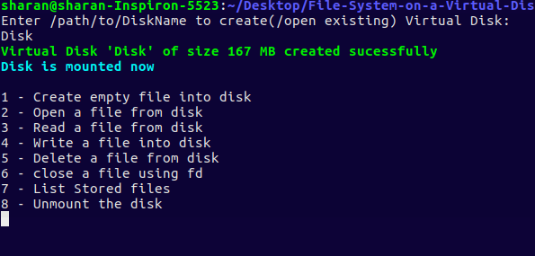
Mount File System
Retrieve the Metadata of Virtual Disk which includes:
Retrieve Super Block
Retrieve Directory Structure
Retrieve Inode List
2) Display basic information regarding disk.

Slide 8
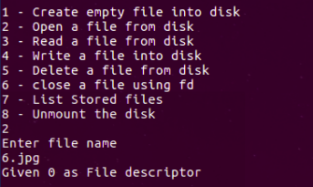
Open File
It gives an error if a) File does not exist. OR b) No filedescriptor is available.
Open the file and assign a filedescriptor to it.

Slide 9
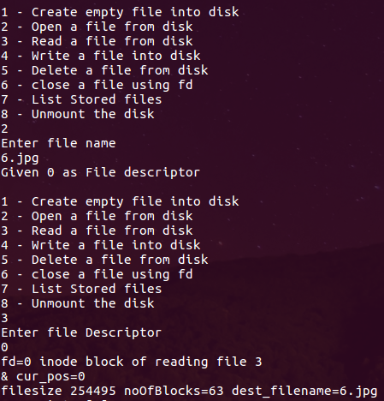
File Read (fd, buf):
File with specified filedescriptor should be opened
Start reading from the cursor position and store the read data into a buffer
Store the buffer content into the new file

Slide 10
Close File
File should be opened with specified file descriptor.
Then close the file and make the particular file descriptor available.

Slide 11
Create File
It will show an error if :
File already exists.
No data block is free
No inode is free.
2) Then it will pick one Data block and one Inode and create the file
3) Make an entry in Directory Structure : a) Store the name of file b) Store the inode number assigned to that file.

Slide 12
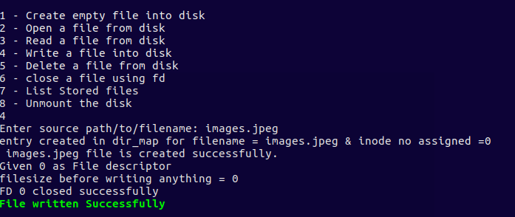
Write data into File(fd, buf)
Flow:
Receive data from application (user) Cur_pos, buf, inode etc
Check disk available space
Write into last DB (if space remaining)
Else assign new empty DB to file & write
Update inode structure (pointer) & file size & set cur_pos
Return success

Slide 13
Delete File:
Logical Flow:
1)File should exist.
2)File should not be opened.
2)Empty the data contained in inode:
Empty the meta data
Empty the pointer fields
3)The inode and data blocks which are free are kept in freelist.
4)Delete the entry from directory map.
5)On success returns 0 else -1.

Slide 14
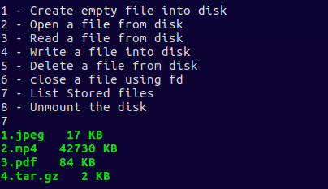
List Files
List all the stored files from DS

Slide 15
Unmounting The Disk:
Logical Flow:
1)Store the changed Metadata information about the disk into the disk which involves
=>update and store the Superblock (SB)
=>store the Directory Structure (DS)
=>store the inode list.

Slide 16
Unmounting The Disk:
Store the changed Metadata information about the disk into the disk which involves
Step 1
Step 2
Step 3
Update and store the Superblock (SB)
Store the Directory Structure (DS)
Store the inode list.

Slide 17
Thank You

